Slide 1
Computer Science A-level coursework
Ben Curtis

Slide 2
SQL reading/writing library
Creating a custom library to be used on the central server that contains all the necessary code to read from and write to an sql database to keep my final project neater with less code repetition.

Slide 3
Necessary sql functions
Append a new value/record to the database as a tuple to prevent sql injection
Replace/overwrite entries when given the new value and the one to be replaced
Read and return a set of records as a 2d array when given the sql code to be executed
Read and write encrypted entries for password security using asymmetrical encryption where a single server has access to the private key

Slide 4
Sequence of events in logins
User enters username + password in plain text
Both are encrypted using the public key
Sent to server
Received by server
Hashed to receive unique id
details authenticated in server database
Ip is associated to username for 24 hours or until logged out
User is “logged in”

Slide 5
Choosing an encryption library and algorithm
I initially planned to use the “pycrypto” library as it seemed simple and lightweight while still being powerful enough to protect my users. However after some research I discovered that this library is unmaintained since 2013 and is therefor not safe for use. This prompted a switch to “cryptography” a more complex encryption library.
For the purpose of sending sensitive passwords to and from a downloadable piece of software a symmetrical encryption algorithm would not be sufficient meaning I had to use an assymetrycal algorithm. I settled on rsa due to its faster validation times and similar security(when using a 2048 character modulus) to dsa while being very well documented.

Slide 6
Db manager comparison
mySQL
SQLite
Industry standard, very well documented and supported
Allows multiple simultaneous edits which may be useful but due to my limited use of the threading module its use case is limited
Cross language making it useful as a skill to learn and be familiar with
More advanced and flexible
Inbuilt server capabilities
I am already intimately familiar with the SQLite browser and python module
SQLite is, as the name implies, very lightweight and simple which is very useful with the time limitations and scope of this project
I have already written useful code I can simply reuse
I have to hack a server together using subpar techniques
Due to my familiarity and already completed work I have decided to keep using SQLite using python socket and pickle serialisation to create the server functionality of mySQL, given more time for this project maybe I would have considered learning mySQL but with the deadline looming and much more to do I have decided to stick with SQLite

Slide 7
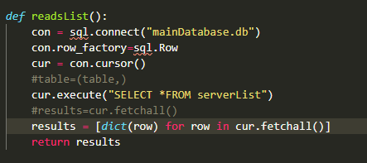
SQL Bugs and problems
This returns each column as a dict key which is not what I want, I want each row to be a record in a dictionary so that I can use the O(1) lookup time with the primary key
Explanation

Slide 8
Analysing sql to dictionary methods and if they are worth it
Linear search for server = O(N)= worst case O(1) = best case O(1/2N) = average as I am looking for a unique primary key
Making it into a dict using loops#
O(N) every time
For the server list I only need to do this once and the list is likely to be relatively short, therefore I will use a linear search here. However if I need to use a db table multiple times converting to a dict will have a an equal avg case and a better worst case of O(N) vs O(2N)

Slide 9
Networking
Creating a python host server that has sole access to the username/password database and private key

Slide 10
Necessary network functions
Be able to verify/add new hashed usernames and passwords using the sql module I wrote
Connect peer to peer networking for games, one host one client. Therefore Server & client code will be needed in each install
Potential server browser if time permits

Slide 11
The port forwarding problem
For python socket servers to work the router must have port forwarding set up. Since this requires admin rights to the router I cant expect users to do this, this gives a few potential solutions shift to a client server model where my pc runs the games. Explore more intentional p2p python libraries such as py2p. Use pythons powerful sys and socket libraries to open a port upon instillation, this will however require another separate executable to be run as administrator or using hole punching which looks like the best option since I will already have a server running which everyone will have to connect to, to host/join anyway. https://en.wikipedia.org/wiki/Hole_punching_(networking)
https://bford.info/pub/net/p2pnat/

Slide 12
The NAT problem solution? ipv6 to the rescue?
Ipv6 doesn’t need NAT as each device has a unique ipv6 rather than routers having ipv4 which redirects to each device on the network which is what makes NAT necessary, so I’m going to be looking at using ipv6 for my peer to peer network

Slide 13
Testing ipv6
Using a socket program I knew worked with ipv4 I tested what changes needed making for ipv6 integration, note that this file will likely be reverted to ipv4 for mass compatibility and tournament games will also likely use ipv4 for the same reason
I tested these changes with and without a vpn on the client to try and simulate an external router, I will still need to trial the real deal at some point though this may be hard as my mobile hotspot doesn’t fully support ipv6 and had some issues(even with ipv4 socket programming)

Slide 14
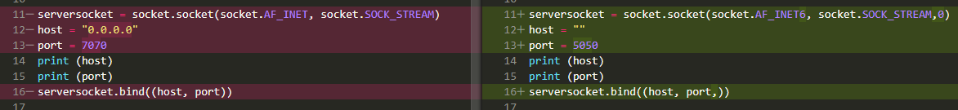

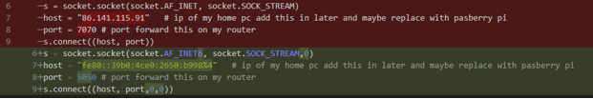

Testing ipv6, host changes/output
Tetsing ipv6, client changes/output

Slide 15
I was previously using link local ip not my public ip which is what caused issues whenoff of my lan

Slide 16
Back to NAT traversal
https://www.youtube.com/watch?v=C8Ik1rJJ3v0
This appears to be a solution to my problem

Slide 17
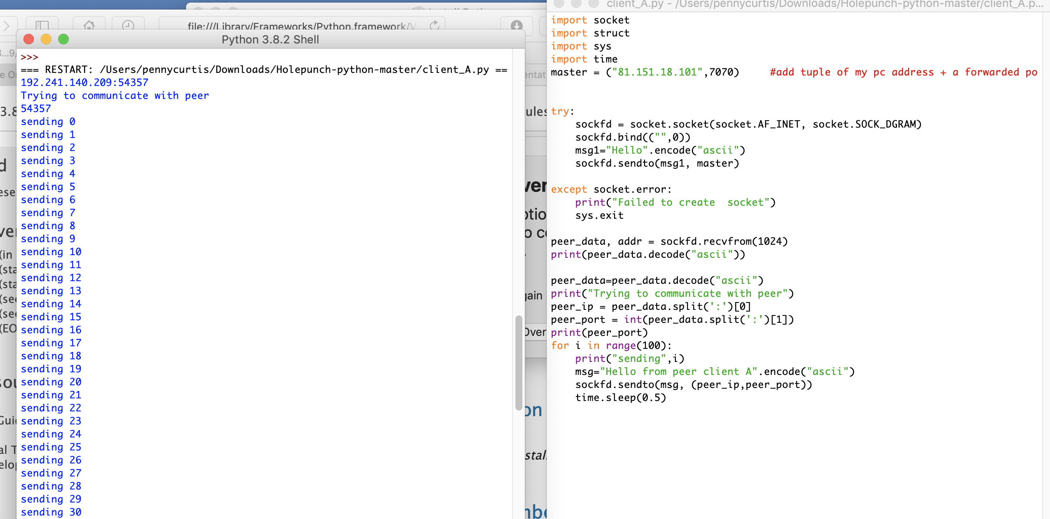
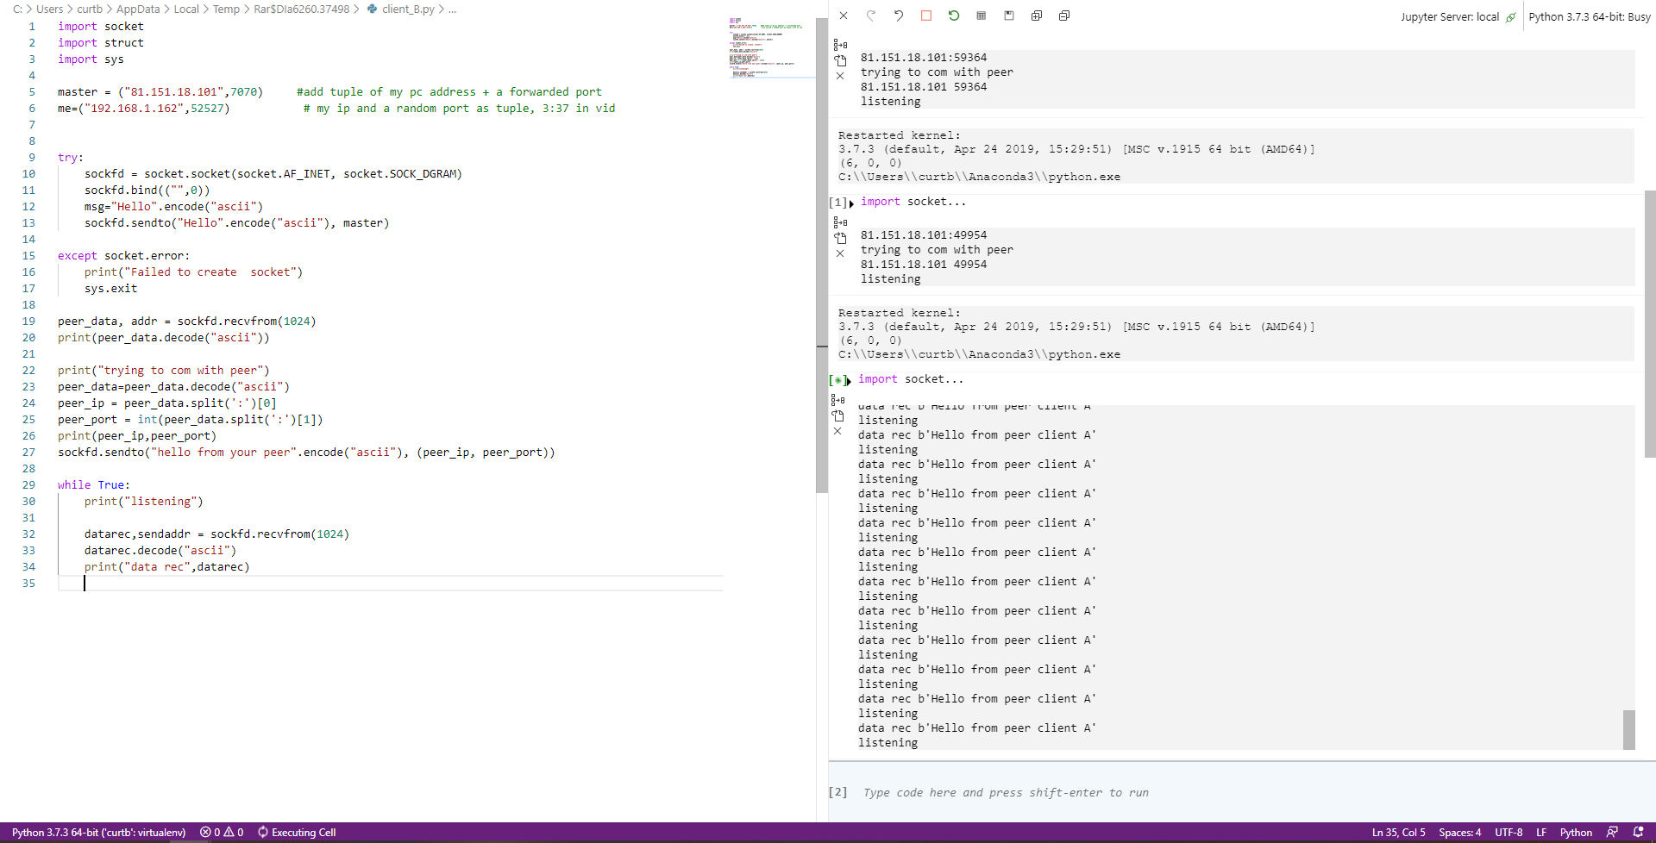
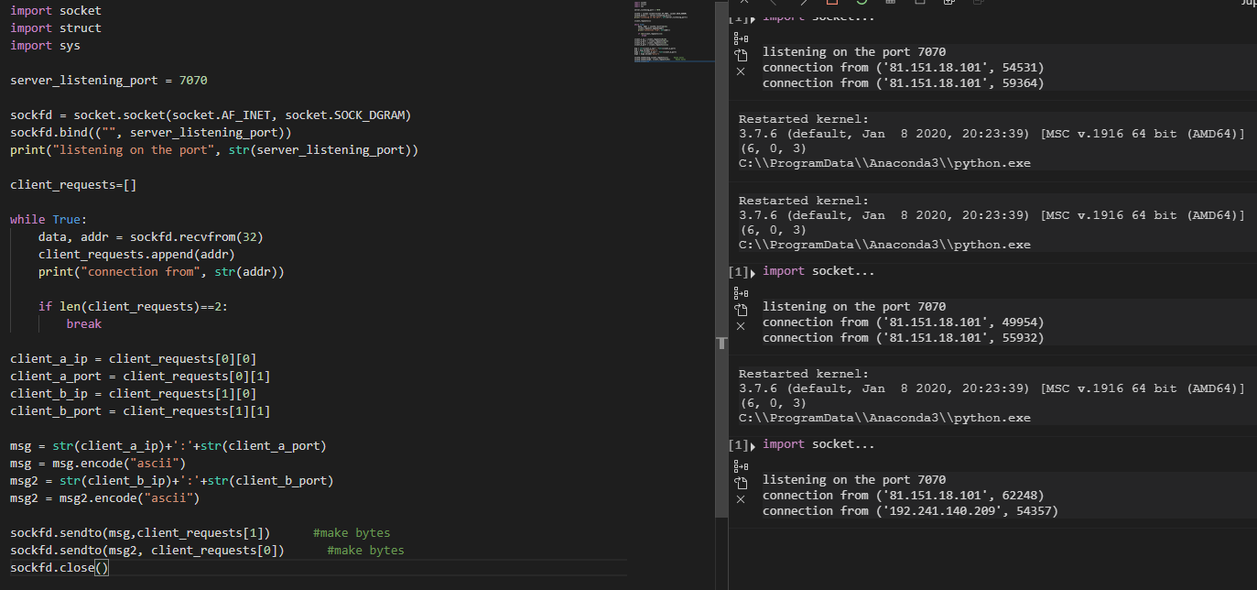
Using and adapting the code from youtube I got 2 peers to communicate with one on a vpn to simulate a different LAN/NAT
This code worked and is a good prototype I can now work into integrating this system into my code, the only problem being the relay server will have to run simultaneous with my logon/primary server, I will look into using threading as a solution to this problem

Slide 18

Test analysis
As you can see here all 100 transmissions were received, this means I may be able to use this technique for single transmissions back and forth as intended

Slide 19
I now need to either find a way of maintaining and managing multiple connections
If I can manage multiple socket connections as the “gamehost” then each transmission will end up going through my server anyway making it less efficient then just using the passthrough method where you have the server contently listening for the client and allowing for easy passthrough.
This is unfeasable and a return to client server is necessary just to get this element of the project done

Slide 20
User backend
A library that includes all the backend functions accessible when logged in with an account

Slide 21
Necessary user functions
View past games(maybe replay functionality)
View their lifetime & recent statistics with graphs+ extrapolation
Update payroll
A preliminary test before booking an appointment to get an early diagnosis
Host/join a game
Add friends for easier game access

Slide 22
Split pot calculations
One challenging part of the game logic will be calculating split pots

Slide 23
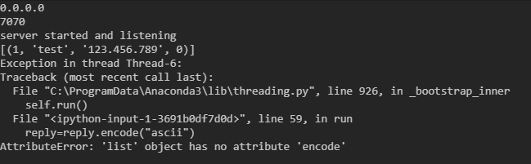
Serialising arrays for data transfer
When attempting to send database tables across the network as python lists, I ran into a problem where I couldn’t encode the array to send it via socket. To fix this I will need to use some form of serialisation, this meant I needed to decide between pickle and json

Slide 24
Serialisation comparison
JSON
Pickle
Human readable
Cross language, don’t plan on using multiple
Industry standard, better documented and supported
Much more safe, as I’m passing ip addresses etc may be an advantage
Cant deal with tuples etc and makes non string keys in dictionaries into strings, this causes issues with my mainloop.py using integer keys on a dictionary
Faster
Can send classes etc which may be useful later down the line to have more flexibility don’t want to import this and json
Allows for data serialization of more data types and better support for pythonic use cases
Could be even faster using cpickle but this is not supported in python 3.x yet
Directly to bytes rather than array -> string -> bytes
Due to the issues with json and the python specific design of pickle I have decided to use pickle.

Slide 25
Useful links crypto
https://en.wikipedia.org/wiki/RSA_(cryptosystem)#Key_generation
https://cryptography.io/en/latest/hazmat/primitives/asymmetric/rsa/
https://cryptography.io/en/latest/hazmat/primitives/asymmetric/
https://security.stackexchange.com/questions/5096/rsa-vs-dsa-for-ssh-authentication-keys

Slide 26
Useful links networking
https://www.tutorialspoint.com/python/python_networking.htm
https://www.w3schools.in/python-tutorial/network-programming/
https://stackoverflow.com/questions/34653875/python-how-to-send-data-over-tcp

Slide 27
notes
ip is allocated to username for 24 hours or until the account is logged out of,
Classes = UI, client, manager

Slide 28
Poker notes
Use dictionary where player num is same as playerID from Player class so chips can be associated with a dynamic number of players

Slide 29
Dictionary of array
You can do this even with using collections
Declare your dictionary as:
Dictionary = {}; // {} makes it a key, value pair dictionary
add your value for which you want an array as a key by declaring
Dictionary[a] = [1,2,3,4]; // [] makes it an array
So now your dictionary will look like
{a: [1,2,3,4]}

Slide 30
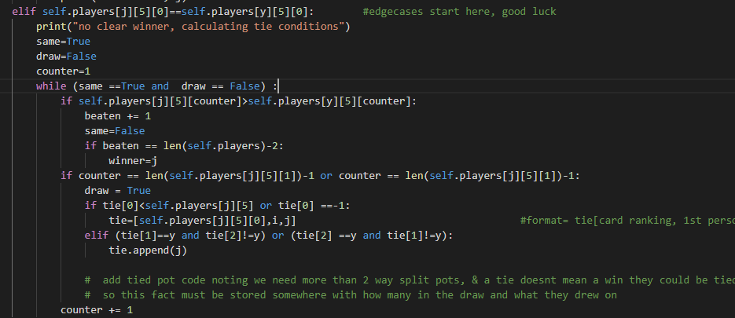
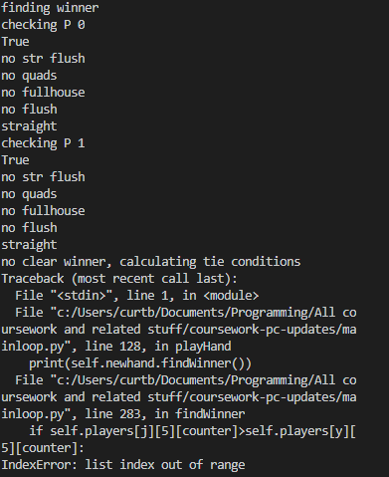
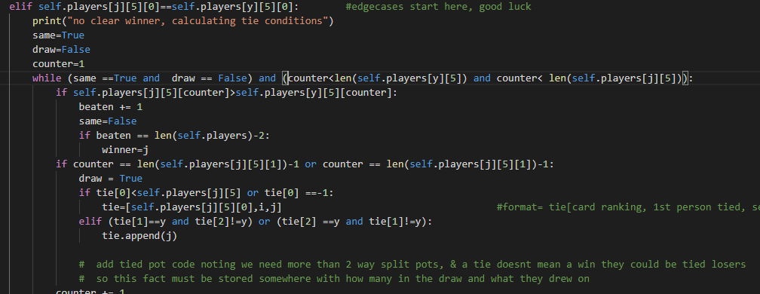
Dev screenshots error 1

Slide 31
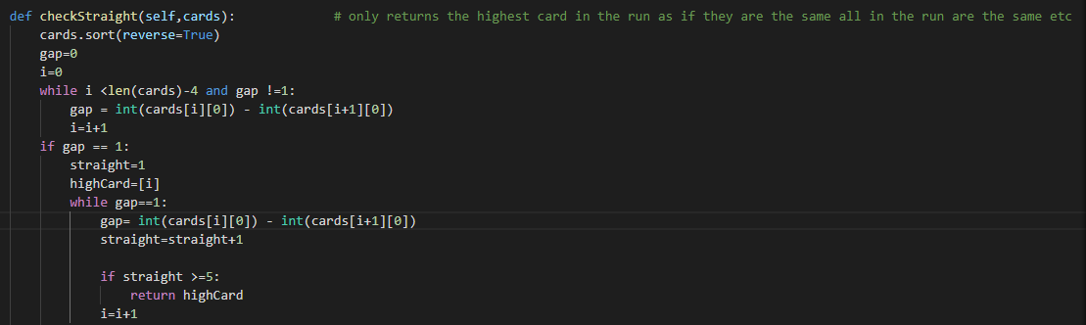

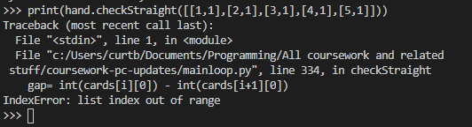
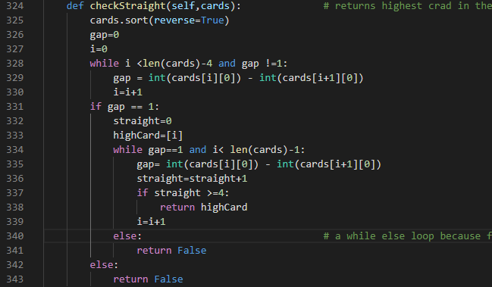
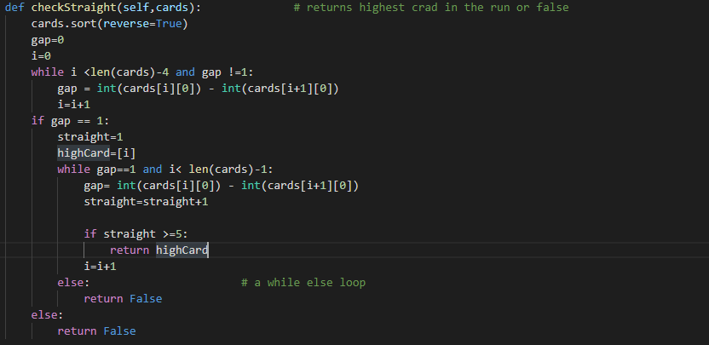
Check Straight function iterative testing

Slide 32
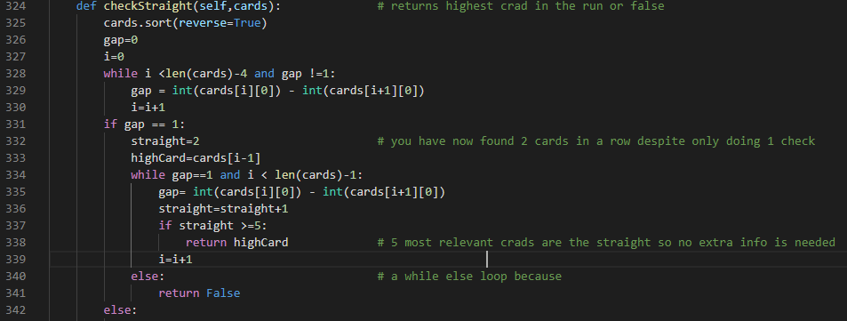
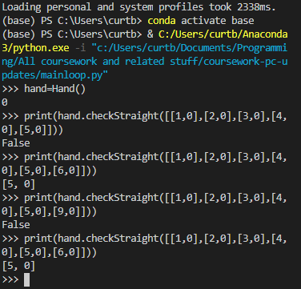
More check straight testing

Slide 33
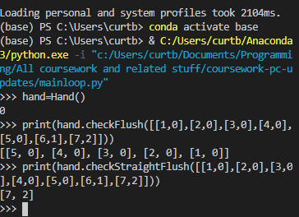

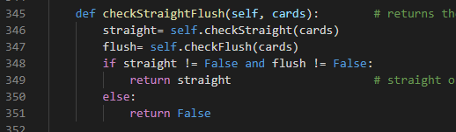
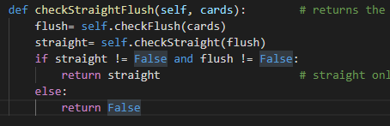
Check straight flush issue,

Slide 34
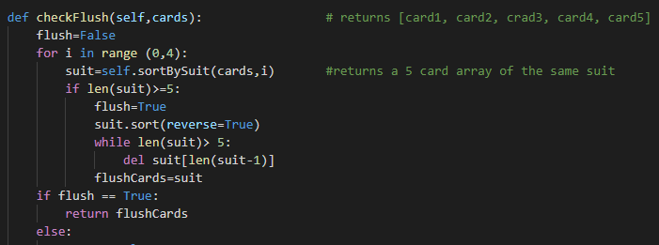
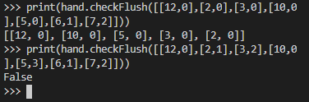
Check flush test + code

Slide 35
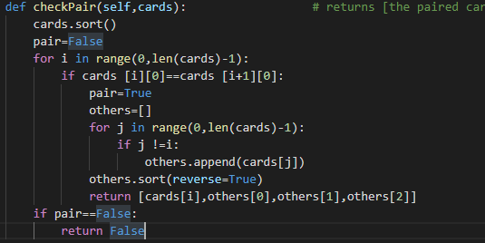
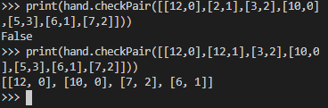
Check pair testing + code

Slide 36
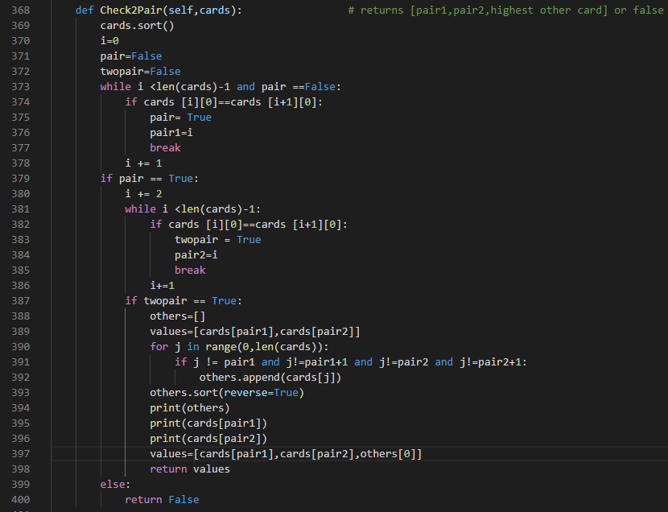
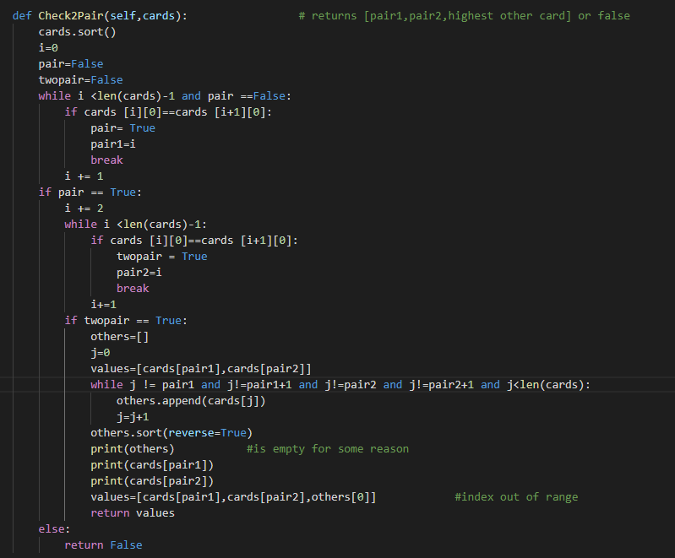
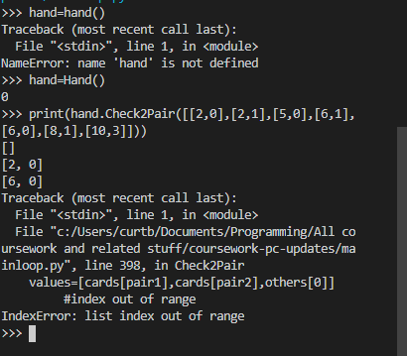
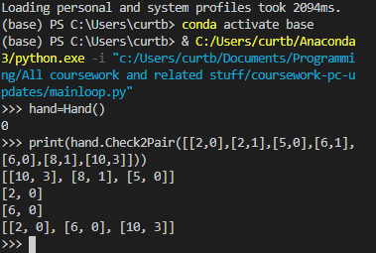
Check 2 pair test/ fix

Slide 37
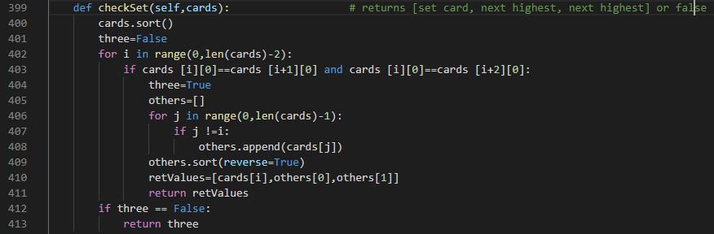


Check set test

Slide 38
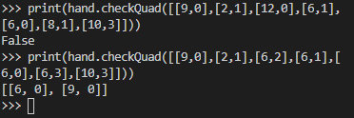
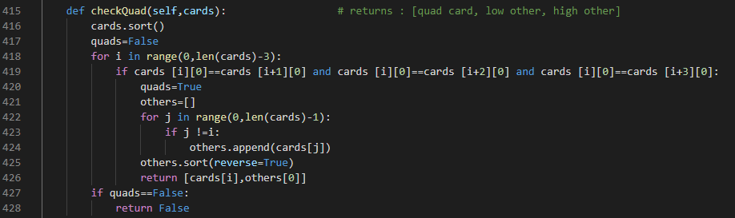
Check quad test

Slide 39
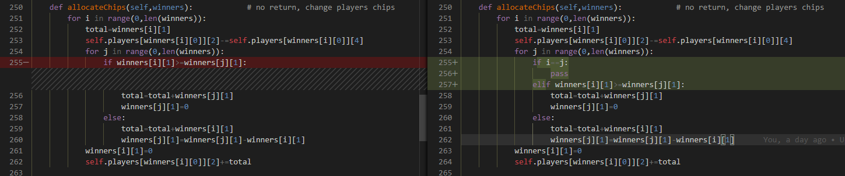
Allocate chips fix/bugs

Slide 40
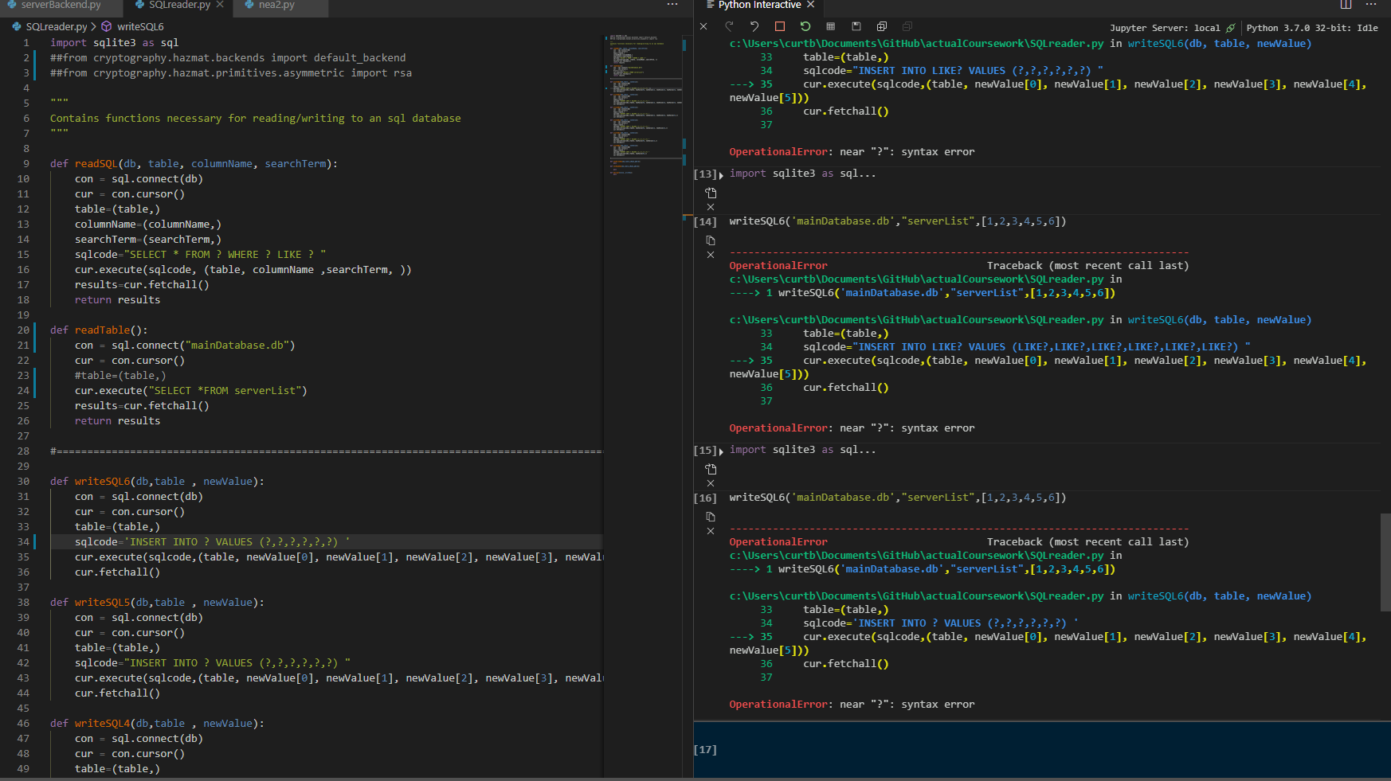
I had several errors in my sql reader as it turns out you cant use a variable to select a table
Due to this my current sql reader based solution may not be worth it as each function must be heavily specialised

Slide 41
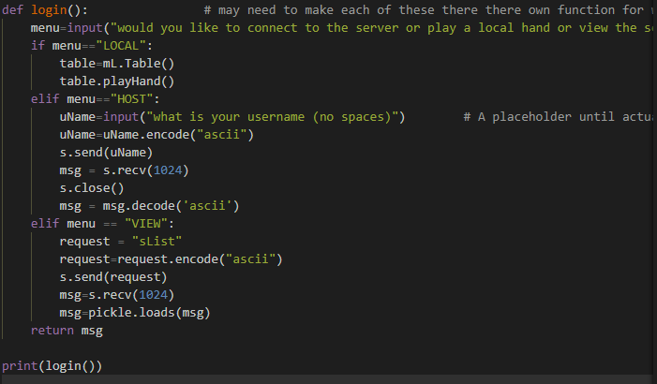
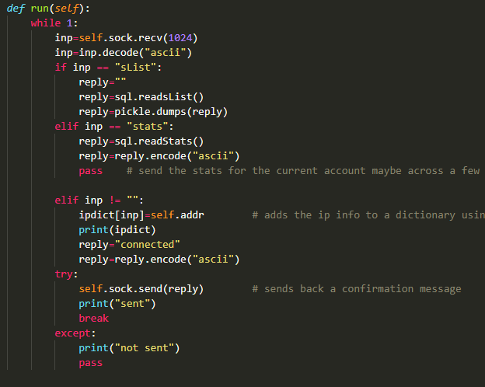
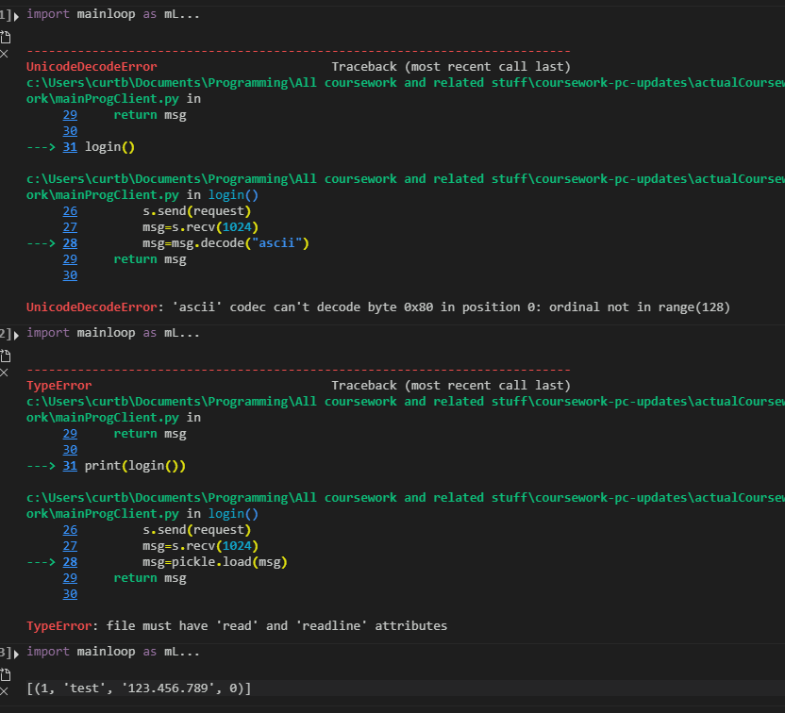
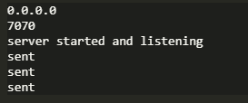
Data transmission tests
I eventually got it to work after using pickle.dumps instead of pickle.dump and not using the .decode(ascii)

Slide 42
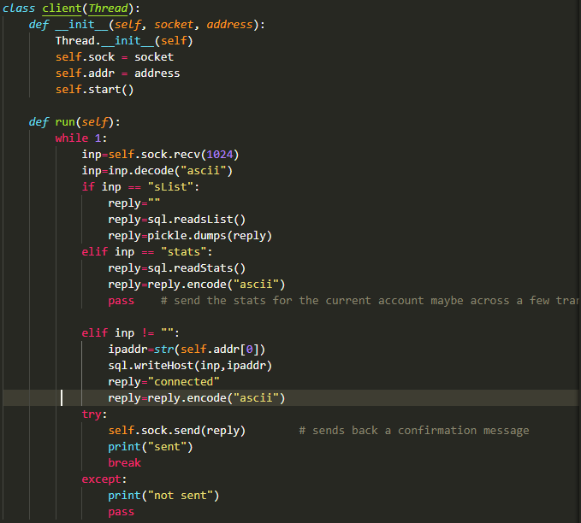
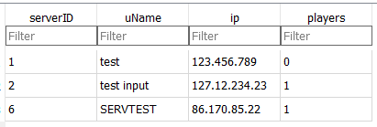
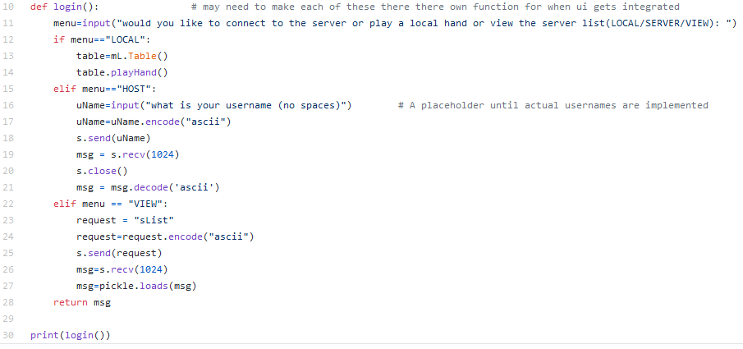

Appending to my “live server db”
The server ID says 6 as I had to delete some test records before this tests so it autoincremented this far, this isn’t really an issue

Slide 43
Hindsight looking at my code
Now I have finished the actual “poker code” of the hands I have realised that creating player objects with encapsulated variables for what is currently stored in my dictionary

Slide 44
pygame
Due to how the event loop and image handling works in pyQT a separate pygame application may be the best solution, there is precedent for this in actual games and applications such as “assetto corsa” or any game with a launcher
This can be launched from a module using parameters from the main application, maybe have it write to local files so that pyQT can them read it when the game finishes

Slide 45
Pyqt for the main game, we’re back. PYGAME BAD
https://wiki.python.org/moin/PyQt5/Threading%2C_Signals_and_Slots using this example I have been able to use qt’s built in threading and signals/slots to allow the ui event loop and my own networking connection loop to run concurrently and pass information to eachother. This solves all of my problems and it should now be smooth sailing

Slide 46
Password security
I decided to hash and salt my passwords as these are the most secure due to the one way hashing in addition to the salt meaning that rainbow tables and duplicate passwords shouldn’t lead to security issues.
This is still less secure than using some third party login such as google or facebook's login system however those require additional work and I want to learn custom password security
I learned of this technique and got the ideas from this article but custom wrote my solution from scratch using python’s cryptography module
https://auth0.com/blog/adding-salt-to-hashing-a-better-way-to-store-passwords/

